Slide 1


Internship Presentation
On
Statistical Arbitrage
(using Machine Learning)
Submitted by:
Devara Meenakshi

Slide 2
Topic:
Statistical Arbitrage: For a family of stocks, generally belonging to the same sector or industry, there exists a correlation between prices of each of the stocks. There, though, exist anomalous times when for a small period of time, the correlation is broken. But the market self corrects in some time and the correlation is re-established. During this small window of time when correlation is anomalous, there exists a money-making opportunity for quantitative traders.
Problem statement:
For a family of stocks, generally belonging to the same sector or industry, there exists a correlation between prices of each of the stocks. There, though, exist anomalous times when for a small period of time, the correlation is broken. But the market self corrects in some time and the correlation is re-established.
“Develop Machine Learning Algorithm to predict statistical arbitrage”.

Slide 3
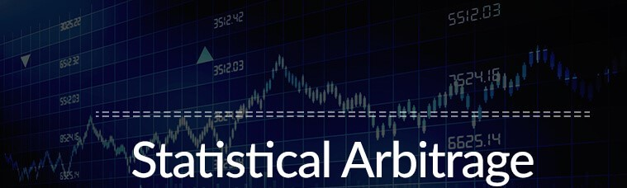
Statistical Arbitrage Model
What is Statistical Arbitrage?
In the world of finance, statistical arbitrage (or Stat Arb) refers to a group of trading strategies which utilize mean reversion analyses to invest in diverse portfolios of up to thousands of securities for a very short period of time, often only a few seconds but up to multiple days. Known as a deeply quantitative, analytical approach to trading, Stat Arb aims to reduce exposure to beta as much as possible across two phases: "scoring" provides a ranking to each available stock according to investment desirability, and "risk reduction" combines desirable stocks into a specifically-designed portfolio aiming to lower risk.

Slide 4

Understanding Statistical Arbitrage:
Statistical arbitrage strategies are market neutral because they involve opening both a long position and short position simultaneously to take advantage of inefficient pricing in correlated securities. For example, if a fund manager believes Coca-Cola is overvalued and Pepsi is undervalued, he or she would open a long position in Coca-Cola, and at the same time, open and short position in Pepsi. Investors often refer to statistical arbitrage as “pairs trading”.

Slide 5
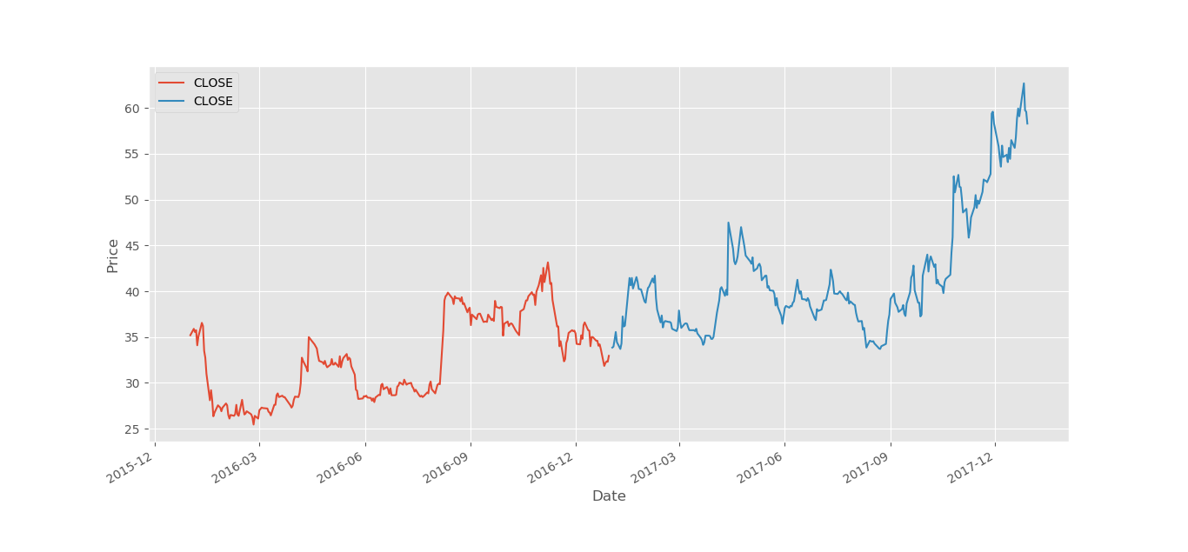
Here is the plot of reports from NSE:2016 & 2017 stocks closing data

Slide 6
Machine Learning Algorithm to predict Statistical Arbitrage:
In order to build a model, we need to follow some steps:
1.Pre-Processing
2.Time series Analysis
3.Classification
4.Prediction

Slide 7
Pre-processing:
Data pre-processing is a process of preparing the raw data and making it suitable for a machine learning model. It is the first and crucial step while creating a machine learning model.
When creating a machine learning project, it is not always a case that we come across the clean and formatted data. And while doing any operation with data, it is mandatory to clean it and put in a formatted way. So, for this, we use data pre-processing task.
A real-world data generally contains noises, missing values, and maybe in an unusable format which cannot be directly used for machine learning models. Data pre-processing is required tasks for cleaning the data and making it suitable for a machine learning model which also increases the accuracy and efficiency of a machine learning model.

Slide 8
Time series Analysis:
A time series is a sequence of data in chronological order, with each datapoint attributed to a specific point in time. The simplest example would be temperature over time, with seasonal variation in line with changing climates. Predicting future variables in these datasets, known as time series forecasting, is an important objective that machine learning aims to full fill. This has several real-world applications, including weather forecasting, earthquake prediction, statistics, and perhaps most useful for business — market forecasting

Slide 9
Main types:
When it comes to time series analysis, there are two main types of datasets: univariate and multivariate.
1. A univariate time series involves time and one other variable, for example temperature. An analysis of the temperature at each time point can give a clue as to what the result will be in future
2.A multivariate time series accounts for other factors that may influence that variable, for instance wind speed, pressure, and rainfall.

Slide 10
Classification:
In machine learning and statistics, classification is the problem of identifying to which of a set of categories (sub-populations) a new observation belongs, on the basis of a training set of data containing observations (or instances) whose category membership is known. Examples are assigning a given email to the “spam” or “non-spam” class, and assigning a diagnosis to a given patient based on observed characteristics of the patient (sex, blood pressure, presence or absence of certain symptoms, etc.). Classification is an example of pattern recognition.
In the terminology of machine learning, classification is considered an instance of supervised learning, i.e., learning where a training set of correctly identified observations is available. The corresponding unsupervised procedure is known as clustering, and involves grouping data into categories based on some measure of inherent similarity or distance.

Slide 11
Classifier:
An algorithm that implements classification, especially in a concrete implementation, is known as a classifier. The term "classifier" sometimes also refers to the mathematical function, implemented by a classification algorithm, that maps input data to a category.
Terminology across fields is quite varied. In statistics, where classification is often done with logistic regression or a similar procedure, the properties of observations are termed explanatory variables (or independent variables, regressors, etc.), and the categories to be predicted are known as outcomes, which are considered to be possible values of the dependent variable. In machine learning, the observations are often known as instances, the explanatory variables are termed features (grouped into a feature vector), and the possible categories to be predicted are classes.

Slide 12
Prediction:
“Prediction” refers to the output of an algorithm after it has been trained on a historical dataset and applied to new data when forecasting the likelihood of a particular outcome, such as whether or not a customer will churn in 30 days. The algorithm will generate probable values for an unknown variable for each record in the new data, allowing the model builder to identify what that value will most likely be.
The word “prediction” can be misleading. In some cases, it really does mean that you are predicting a future outcome, such as when you’re using machine learning to determine the next best action next best action in a marketing campaign. Other times, though, the “prediction” has to do with, for example, whether or not a transaction that already occurred was fraudulent. In that case, the transaction already happened, but you’re making an educated guess about whether or not it was legitimate, allowing you to take the appropriate action.

Slide 13
Implementation:
Libraries to be imported for this analysis:
import pandas as pd import numpy as npfrom datetime import datetime #to plot within notebook import matplotlib.pyplot as plt from matplotlib import style style.use('ggplot') ##%matplotlib inline#for normalizing data from sklearn.preprocessing import MinMaxScaler scaler = MinMaxScaler(feature_range=(0, 1)) from sklearn.feature_extraction import DictVectorizer from sklearn.model_selection import train_test_splitfrom sklearn.linear_model import LinearRegressionfrom sklearn.metrics import recall_score, precision_score from mlxtend.plotting import plot_decision_regions

Slide 14
To begin with data processing, feature and target selection is important. In NSE data the given features are [ ‘OPEN’, ‘HIGH’, ‘LOW’, ‘TOTTRDQTY’, ‘Date’, ‘PREVCLOSE’, ‘TOTTRDVAL’, ‘TOTALTRADES’ ] and the labels are their corresponding [ ‘CLOSE’ ] values.
#Read data stocks = pd.read_csv('nse_data_new.csv') print(stocks.head()) stocks = stocks[[‘OPEN’, ‘HIGH’, ‘LOW’, ‘CLOSE’, ‘TOTTRDQTY’, ‘Date’, ‘PREVCLOSE’, ‘TOTTRDVAL’, ‘TOTALTRADES’]]

Slide 15
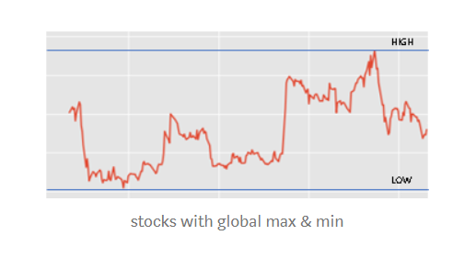
For dimensionality reduction, we need to take common feature from High and Low values which is HL_PCT = ( [ HIGH — LOW ] / LOW ) * 100 and replaced both HIGH and LOW features with HL_PCT.
stocks[‘HL_PCT’] = (stocks[‘HIGH’] — stocks[‘LOW’]) / stocks[‘LOW’] * 100.0 stocks = stocks[[‘OPEN’, ‘HL_PCT’, ‘CLOSE’, ‘TOTTRDQTY’, ‘Date’, ‘PREVCLOSE’, ‘TOTTRDVAL’, ‘TOTALTRADES’]]

Slide 16
We need to perform time series analysis to separate test from train data.
#Time Series Analysis start16 = datetime(2016, 1, 1) end16 = datetime(2016, 12, 31) stamp16 = pd.date_range(start16, end16)start17 = datetime(2017, 1, 1) end17 = datetime(2017, 12, 31) stamp17 = pd.date_range(start17, end17)stocks['Date'] = pd.to_datetime(stocks.TIMESTAMP,format='%Y-%m-%d') stocks.index = stocks['Date']

Slide 17
All the 2016 reports are placed in train dataset and 2017 reports are placed in test dataset.
train = [] test = [] for index, rows in stocks.iterrows(): if index in stamp16: train.append(list(rows)) if index in stamp17: test.append(list(rows))train = pd.DataFrame(train, columns = stocks.columns) test = pd.DataFrame(test, columns = stocks.columns)

Slide 18
Pre-Processing the Train Data:
X_train = train[['HL_PCT', 'OPEN', 'TOTTRDQTY', 'TOTTRDVAL', 'TOTALTRADES']] x_train = X_train.to_dict(orient='records') vec = DictVectorizer() X = vec.fit_transform(x_train).toarray() Y = np.asarray(train.CLOSE) Y = Y.astype('int')#Pre-Processing Test data X_test = test[['HL_PCT', 'OPEN', 'TOTTRDQTY', 'TOTTRDVAL', 'TOTALTRADES']] x_test = X_test.to_dict(orient='records') vec = DictVectorizer() x = vec.fit_transform(x_test).toarray() y = np.asarray(test.CLOSE) y = y.astype('int')

Slide 19
Let’s move to building our Machine Learning - regression model to predict those Closing values using training features. TheilSen Regressor is one of the best regression classifier for our data.
#Classifier from sklearn.linear_model import TheilSenRegressor clf = TheilSenRegressor() clf.fit(X, Y) print("Accuracy of this Statistical Arbitrage model is: ",clf.score(x,y)) predict = clf.predict(x) test['predict'] = predict

Slide 20
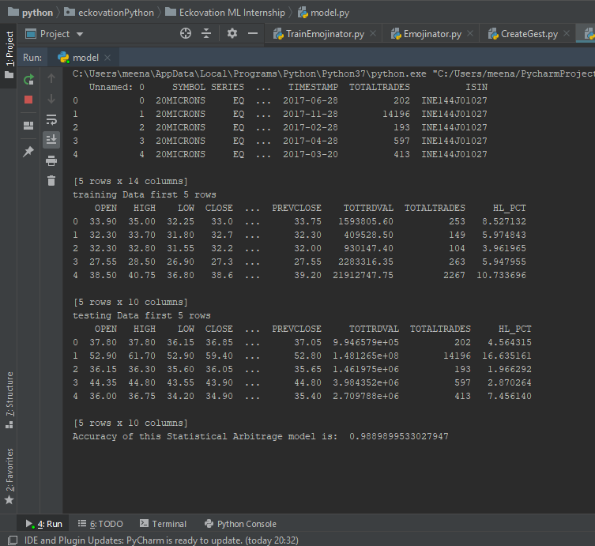
Accuracy score of our model is 98.8% which is decent for a yearly predictions

Slide 21
To plot the prediction results:
#Ploting train.index = train.Date test.index = test.Date train['CLOSE'].plot() test['CLOSE'].plot() test['predict'].plot() plt.legend(loc='best') plt.xlabel('Date') plt.ylabel('Price')
Plt.title(‘plot between Date and Price’) plt.show()

Slide 22
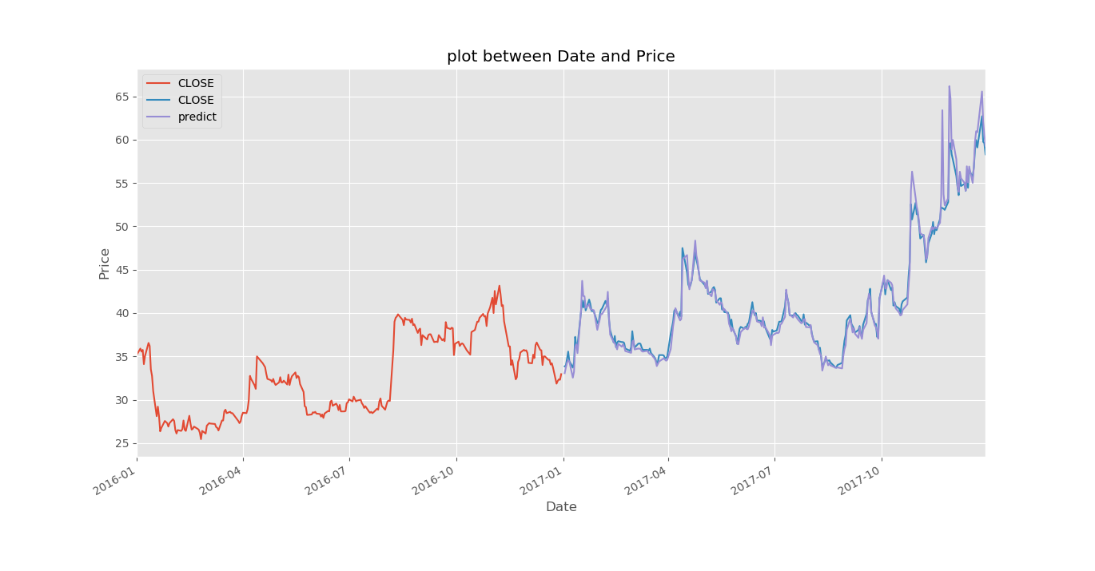
The graph plotted between stock values and date along with prediction over 2017 dataset:

